Slide 1
Exclusion and Inclusion

Slide 2
Definition for Bullying
‘Bullying is in-person and online behaviour between children
and young people within a social network that causes physical, emotional, or social harm to targeted young people. It is characterised by an imbalance of power that is enabled or inhibited by the social and institutional norms and context of schools/organisations and the education system. Bullying implies an absence of effective responses and care towards the target by peers and adults.’
UNESCO 2020

Slide 3
The Dangers of Exclusion
Many people assume that social exclusion and rejection are expected parts of growing up and are not really bullying.
It is true that not all instances of rejection or exclusion are bullying

Slide 4
Social Exclusion
Social Exclusion is now recognized as a subgroup of bullying.
This means that idea of excluding someone repeatedly, aggressively and on purpose with the intent to cause emotional harm to them, is right up there with verbal, physical and cyber bullying.
Social exclusion is bullying when someone feels alone or left out because of the manipulation of their peer relationships and social status.
Social Exclusion is not bullying when say, people make new friends and distance themselves from old friends.
That old friend may feel as though they are being “socially excluded” but if there is no aggressive intention to cause harm, they are not being bullied.
There is a difference, and it is not always easy to tell the difference.

Slide 5
Why Exclusion Can be Hurtful
Social exclusion is one form of relational aggression, a subtle and indirect type of bullying
Social exclusion is the act of rejecting someone from interpersonal interactions.
Social exclusion can also happen when
Unpleasant rumours are spread about a person
Through cyberbullying
In the classroom and in the Yard
Social activities or events inside of school or outside of school

Slide 6
Why People Exclude
Sometimes we exclude others because they are different from us, because of their
Gender
Race
Nationality
Disability
Their interests
Sometimes because they are shy or quite
Being Excluded can make a person feel sad, depressed, lonely, angry, hurt and can influence the persons self-esteem.
Studies show us that being excluded or feeling social rejection affects our brains in the same way that physical pain does.

Slide 7
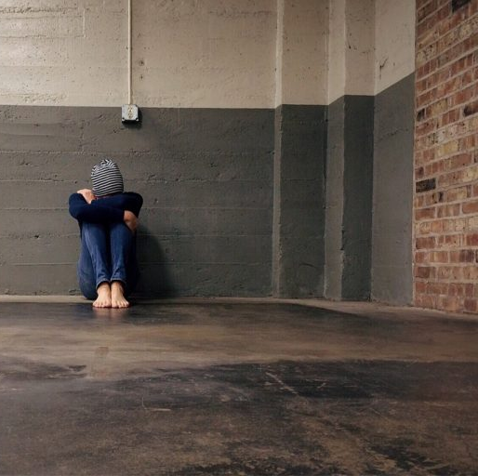
Examples Exclusion
Leaving someone out on purpose when you know they will be hurt by your actions.
Telling other students not to be friends with someone.
Embarrassing someone in public when someone tries to approach the group.

Slide 8
How Can We as a Class Include Others?
In Class Discussion

Slide 9
What We Can Do
If you feel you are being excluded reach out to talk to an adult, you trust or contact Childline.
When we included people and offer friendship, this can have a positive impact in how we feel both physically and mentally.
It takes far less energy to include someone than it does to exclude them.
It is important to treat others how we ourselves want to be treated.

Slide 10
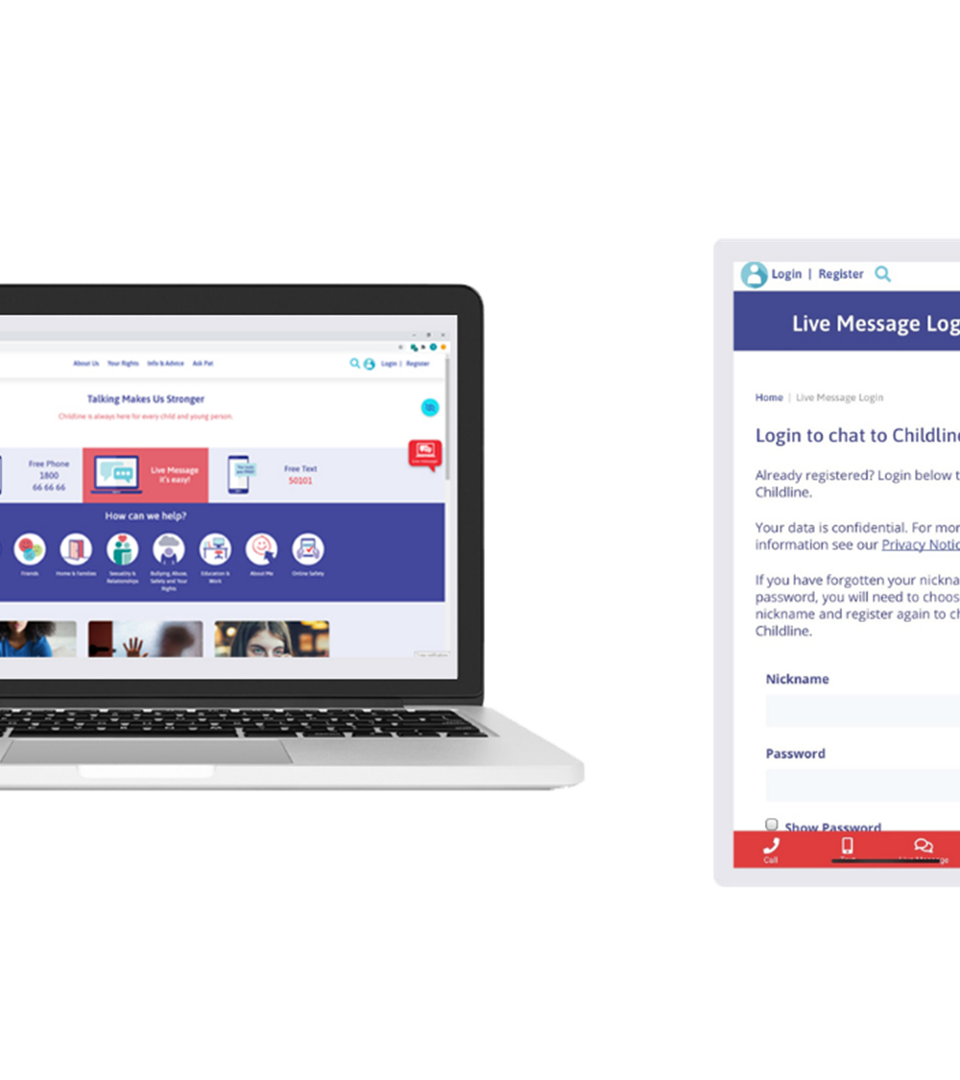
Contact Childline
24 hours, 365 days
FREE
Confidential
Non-Judgmental
Call 1800 66 66 66

