Slide 1
Bullying
–What should
parents know
Written By Amy Hurley
Shield Volunteer

Slide 2
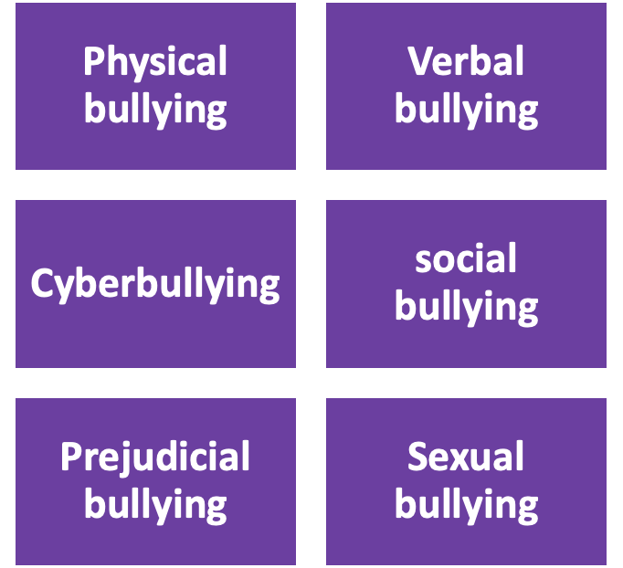
What is Bullying
According to the Department of education, bullying can be defined as unwelcome, bad behaviour which continues to occur over time and is either verbal, psychological, or physical towards another person or group.
Bullying can occur in a variety of settings such as in school and online, particularly if adult supervision is poor.
Bullying can include posting one singular insulting or harmful public message, image, or comment on a social networking site or some other public setting where it can be seen or repeated by others
Bullying involves three parties; The Bully, the Target of bullying and the Bystander
There are 6 main types of bullying

Slide 3
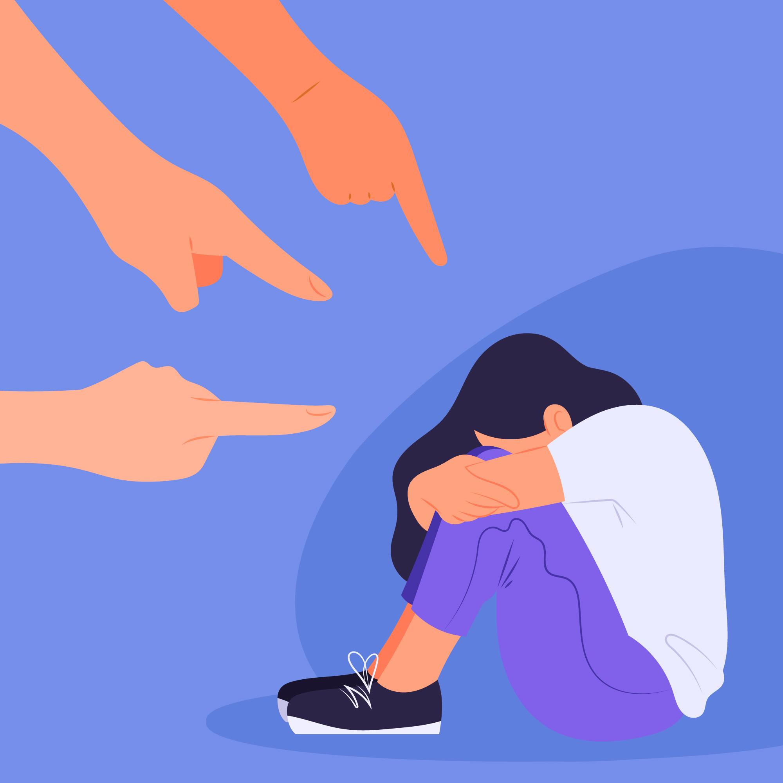
Bullying – is not always seen and often not reported because children:
Are embarrassed
Fear the bully might retaliate
Don’t want to seem weak
Might not know how to talk about it
Believe they deserve it
Think nothing can be done about it
Some signs and symptoms of being bullied include:
Damage or loss of personal property
Physical signs like cuts and bruises
Becoming more socially isolated, avoiding peer interactions
Changes in mood; becoming angry, aggressive, sad, lonely
Problems eating and/or sleeping
Bed wetting
Complaints of stomach pains, headaches, illness (more frequently than before)
Reduced academic achievements

Slide 4
Cyber-bullying
Pointers for parents:
Keep the computer in a visible and communal place and agree upon responsible internet usage
Explore internet safety with your child, reminding him or her not to share personal information
Discuss what should happen if your child is ever cyberbullied
Ignore the message
Block the sender
Take a screenshot as evidence of the bullying
Contact website admin if a bullying web page has been created
Be supportive to help encourage your children to tell if they are being cyberbullied

Slide 5
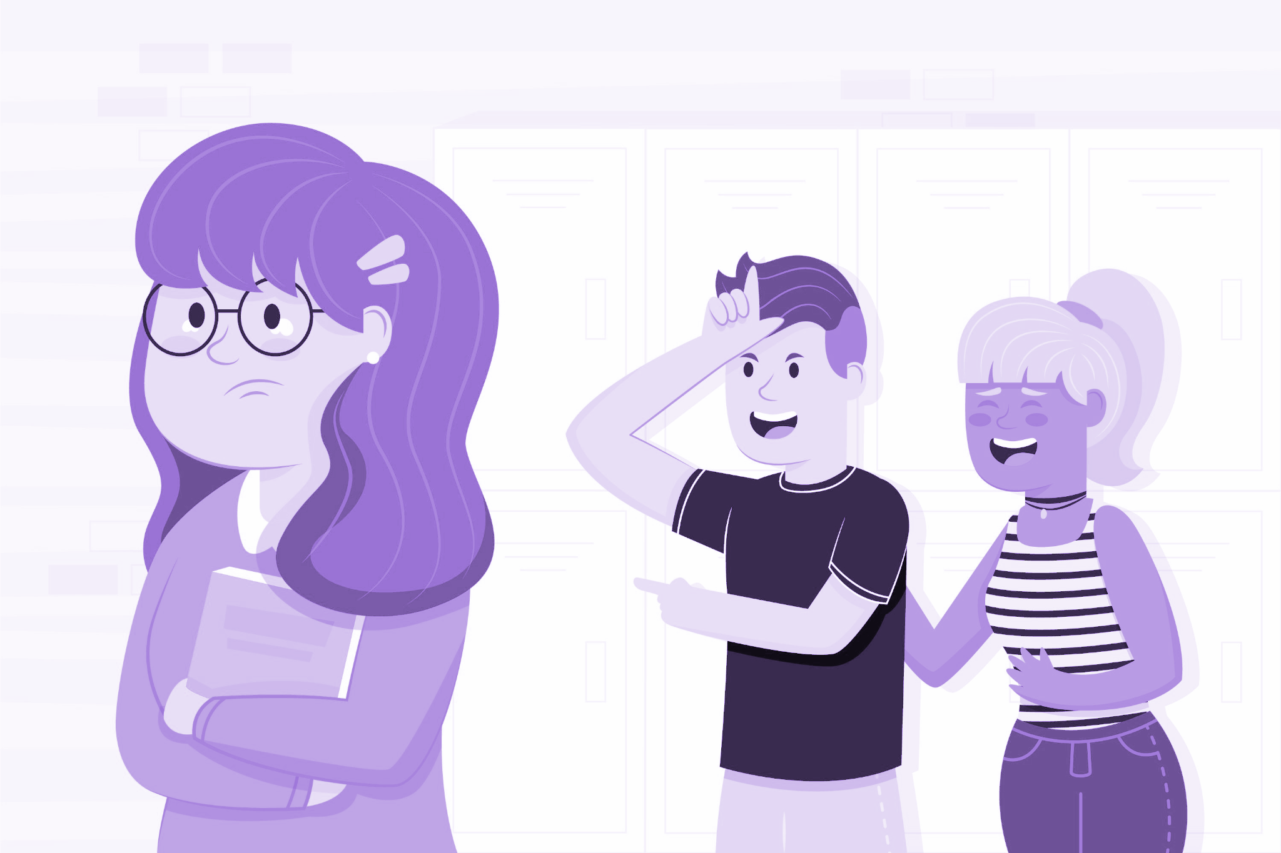
Impact of Bullying on the Bully
Research shows us that those who bully others have lower levels of self esteem than their peers.
Children who have bullied others statistically show higher rates of aggression, antisocial behaviours, crime convictions, poor emotional control, and depression later in life.
Bullies are rewarded for their bullying behaviours – Enjoy the status and the fact that other young people will support them (By laughing or joining in)
Bullies tend to lack empathy, but we can help them to develop this further
Preventing bullying is most successful when tackled early in a child’s life.
Image by <a href="https://www.freepik.com/free-vector/bullying-illustration-concept_8918593.htm#query=bully&position=25&from_view=search&track=sph">Freepik</a>

Slide 6
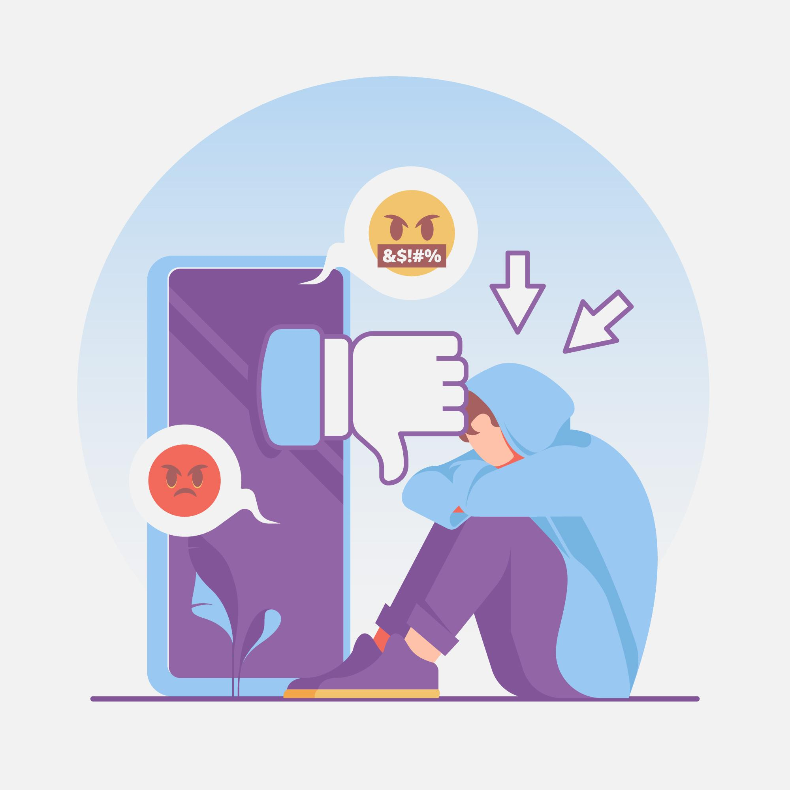
The Target
Anyone can be bullied, but some children are more likely to be victimised for particular reasons where so-called “differences” appear.
Acceptance for individual differences is key, personality traits can be very hard to change, and it may be very unfair to ask this of a target.
Ways to reduce the impact of bullying:
Improving your child’s self confidence
Developing your child’s coping skills and resilience
“Avoiding the bully’s tactics”
Having social support is crucial for your child.
Modelling self-love and encouraging the development of your child's self-love
Image by <a href="https://www.freepik.com/free-vector/stop-bullying-concept_9005195.htm#page=4&query=bully&position=2&from_view=search&track=sph">Freepik</a>

Slide 7
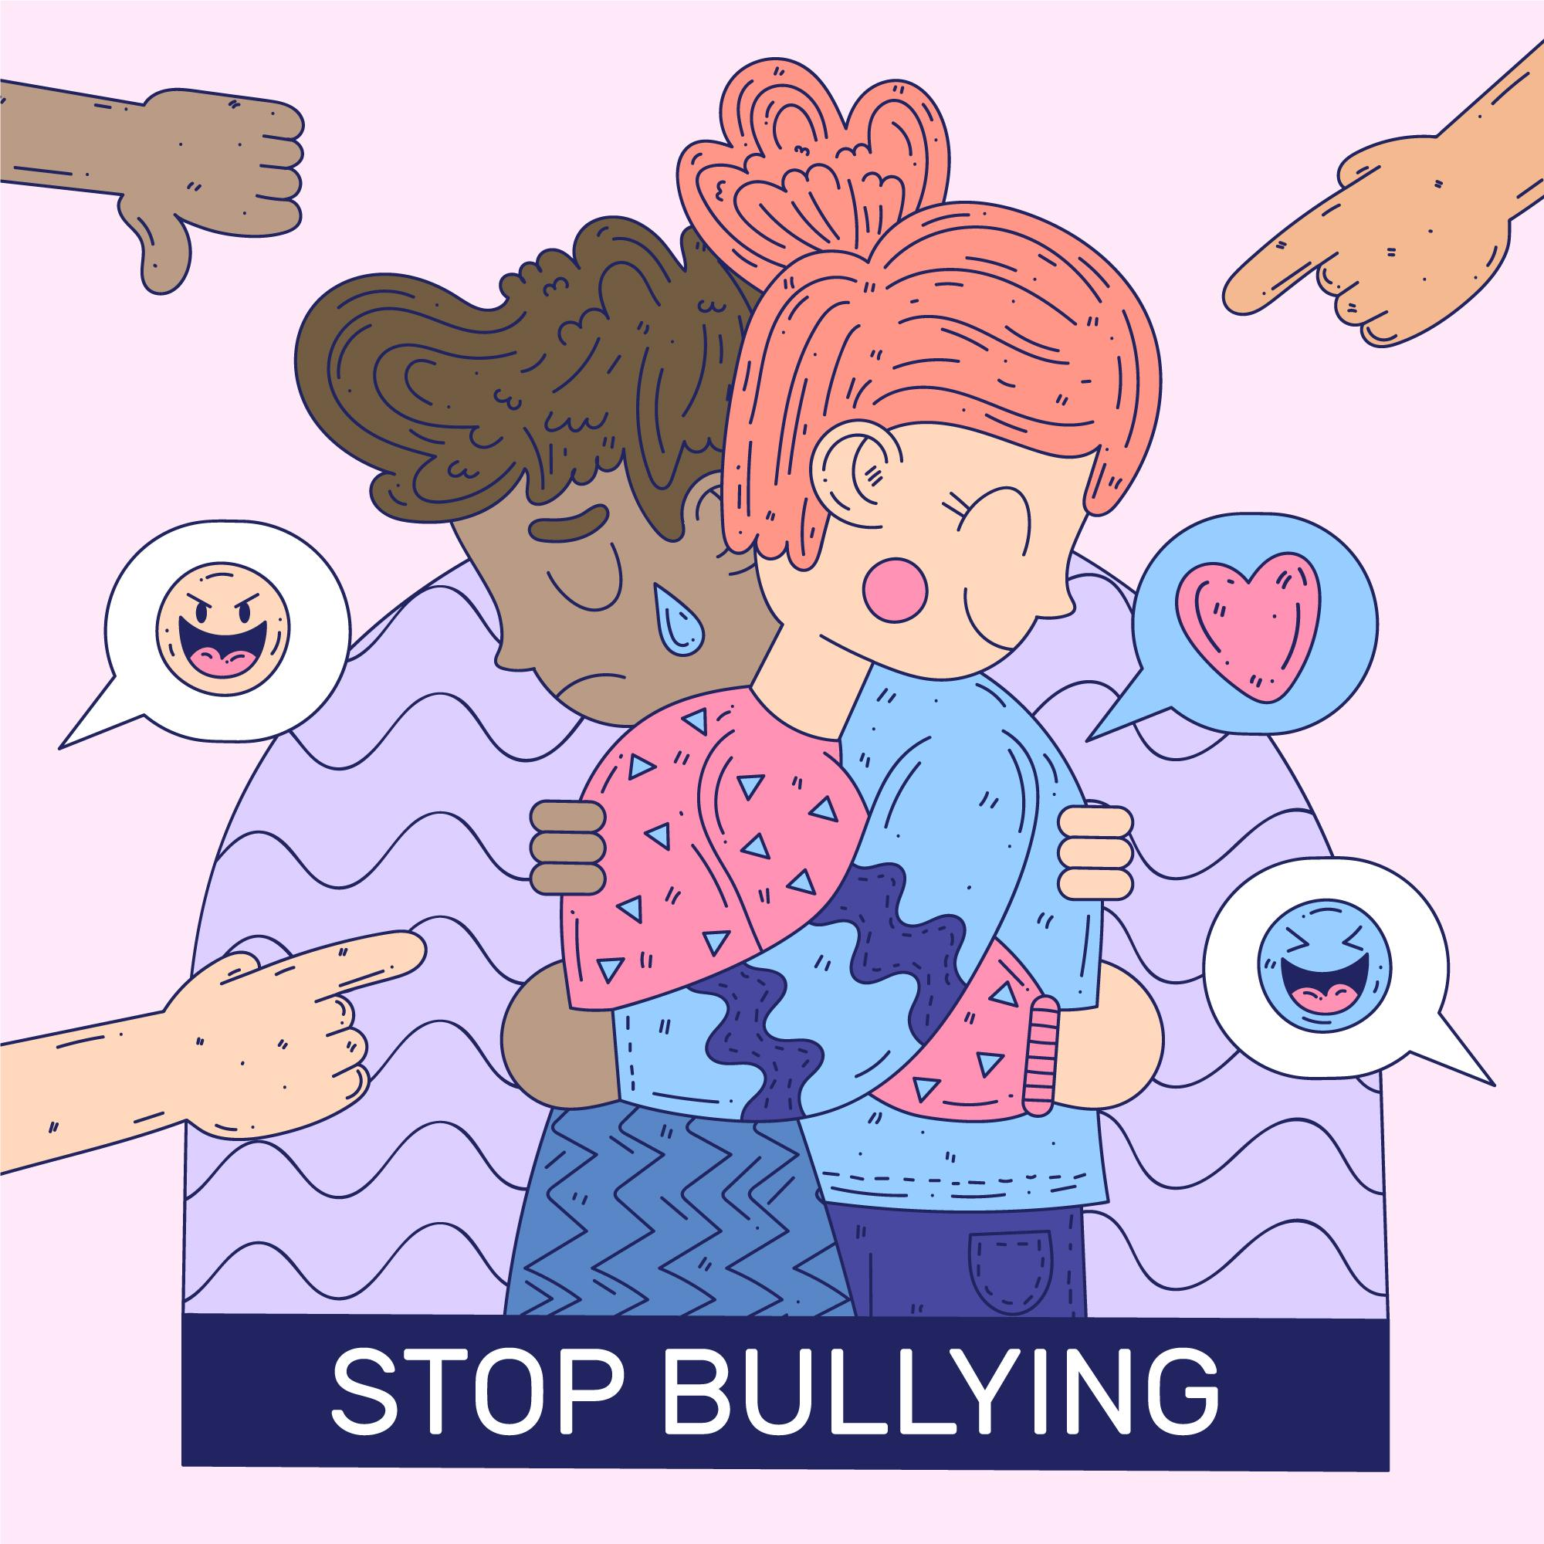
The Bystander
Bystanders are witnesses who may see bullying behaviour, or others who hear about bullying incidents
The most successful anti-bullying interventions have a strong focus on the role of the bystander and how they can help prevent bullying
There are 3 main types of bystander.
Followers (assistants) - while they don't initiate the bullying, they support the bully by taking an active role in the bullying behaviour.
Supporters (reinforcers) - they support the bullying behaviour through direct means e.g. by cheering or encouraging the bully and indirect means e.g. by laughing or smiling).
Outsiders (passive bystanders) - they don't take any sides and avoid any involvement in the bullying - this can be hurtful and act as reinforcement.
Defender - they support and comfort the target or redirect the situation away from bullying (deflecting the behaviour). To stop the bullying they get help from others: teachers, trusted adults, or peers.
Image by <a href="https://www.freepik.com/free-vector/stop-bullying-illustration-design_9099552.htm#page=2&query=social%20bullying&position=7&from_view=search&track=ais">Freepik</a>

Slide 8
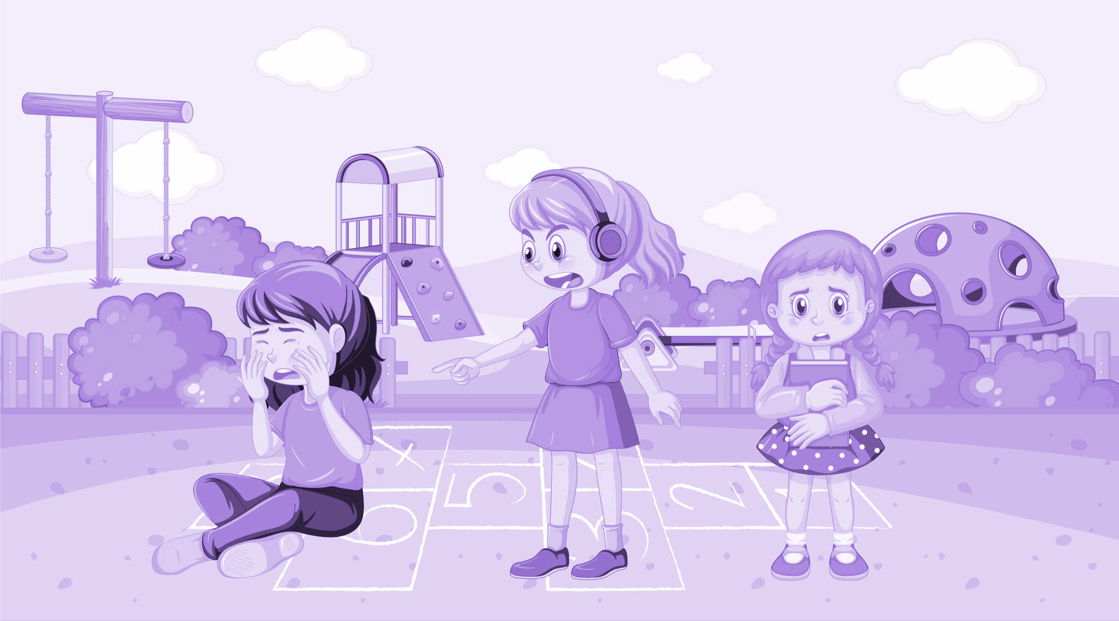
The Bystander
Why don’t bystanders step up more?
The fear factor - by reporting the bullying they may become a target themselves
Not sure what to do or what to say
Might feel powerless to help
“It’s none of my business”
They don’t want to draw attention to themselves
They think telling an adult won’t help
They might not like the target, or think they deserve it
Bystanders need to feel supported by school and parents to feel confident in reporting bullying concerns
<a href="https://www.freepik.com/free-vector/school-bullying-with-student-cartoon-characters_35822323.htm#query=bully&position=49&from_view=search&track=sph">Image by brgfx</a> on Freepik

Slide 9
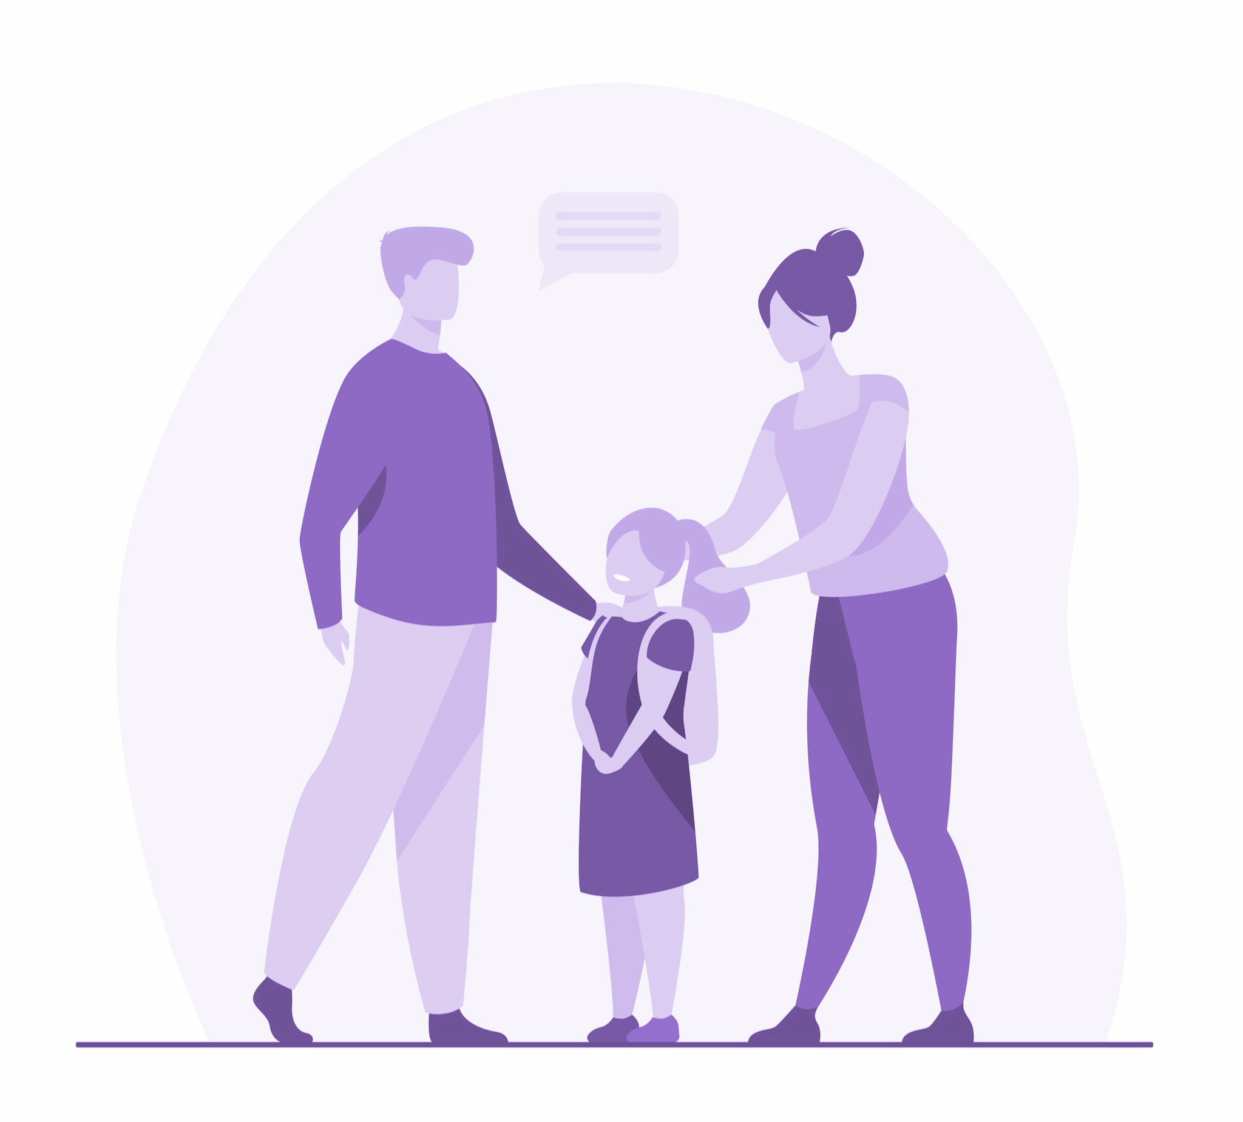
What Parents Can Do?
Be a good role model: Children will learn by example i.e. We cannot expect children to react differently, Parents are a very strong source for their learned behaviours.
Reflect on how you solve problems and conflict in your life
Do you control your anger or let it get the better of you? Do you stand up for yourself positively?
Develop as positive a relationship as you can with your child.
Encourage children to report bullying and talk about it more openly.
Let's raise your own awareness of bullying and the responses that work best to this negative type of behaviour.
Be proactive - A good rule of thumb is to let the school know of any bullying problems even if it does not happen in the school.
Build a good relationship with your child’s school to help facilitate positive anti bullying policies.
It is not only the schools responsibility to respond to bullying issues.
<a href="https://www.freepik.com/free-vector/parents-preparing-cute-daughter-school-love-study-backpack-flat-illustration-cartoon-illustration_12699802.htm#query=parents&position=0&from_view=search&track=sph">Image by pch.vector</a> on Freepik

Slide 10
What Parents Can Do?
Parents of the bully
Explore how they feel after they bully others and how the bullied child might feel.
Encourage them to take responsibility for their actions and what the possible consequences of bullying others may be
Be clear about your expectations and boundaries
Remind your child that you love them, and that you will be there to support them to change this behaviour
Parents of the target
Remind your child that the bullying is not their fault
Explore what your child would like to see happen next
Keep an open dialogue with your child’s school to let them know of any concerns
The best response might be to walk away.
Always let a trusted adult know what is happening

