Slide 1
Bullying
–What’s it All
About?
SHIELD Anti-Bullying Programme

Slide 2
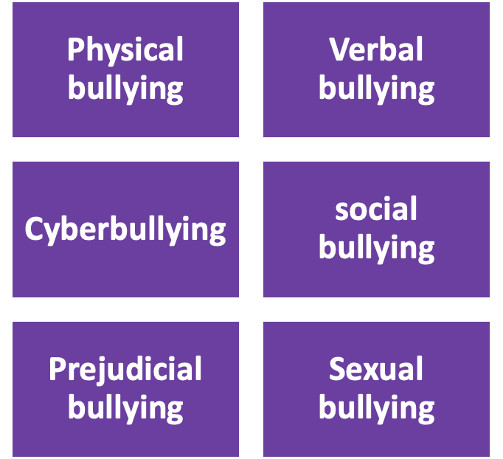
Definition of Bullying
Bullying – According to the Department of education, bullying can be defined as unwelcome, bad behaviour which continues to occur over time and is either verbal, psychological, or physical towards another person or group.
Bullying can occur in a variety of settings such as in school and online, particularly if adult supervision is poor.
Citizens information (2023) also suggests that bullying can include posting one singular insulting or harmful public message, image, or comment on a social networking site or some other public setting where it can be seen or repeated by others
There are 6 main types of bullying

Slide 3
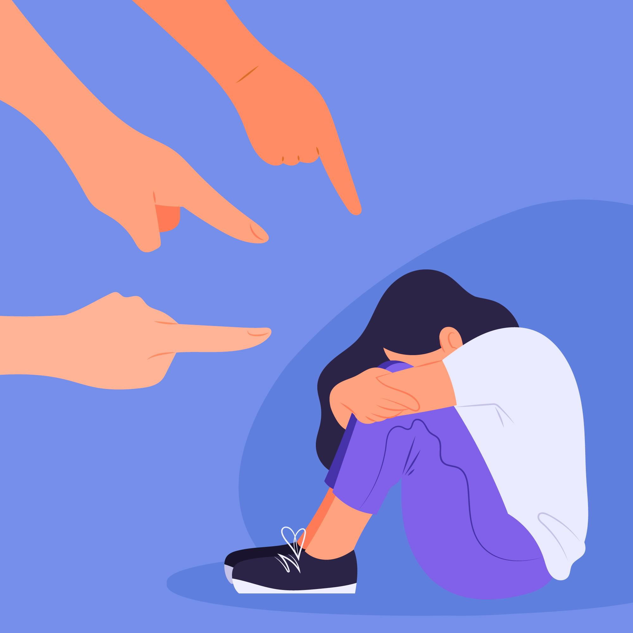

Physical
Bullying
Physical Bullying – is the easiest form of bullying to identify. It involves using physical force to harm or intimidate another person.
This involves slapping, hitting, punching, shoving, kicking or damaging the belongings of another individual.
Boys are more prone than girls to engage in physical bullying (Lansford et al., 2012).
Image by <a href="https://www.freepik.com/free-vector/hand-drawn-woman-feeling-shame-illustration_23985803.htm#page=8&query=stop%20bullying&position=10&from_view=keyword&track=ais">Freepik</a>

Slide 4
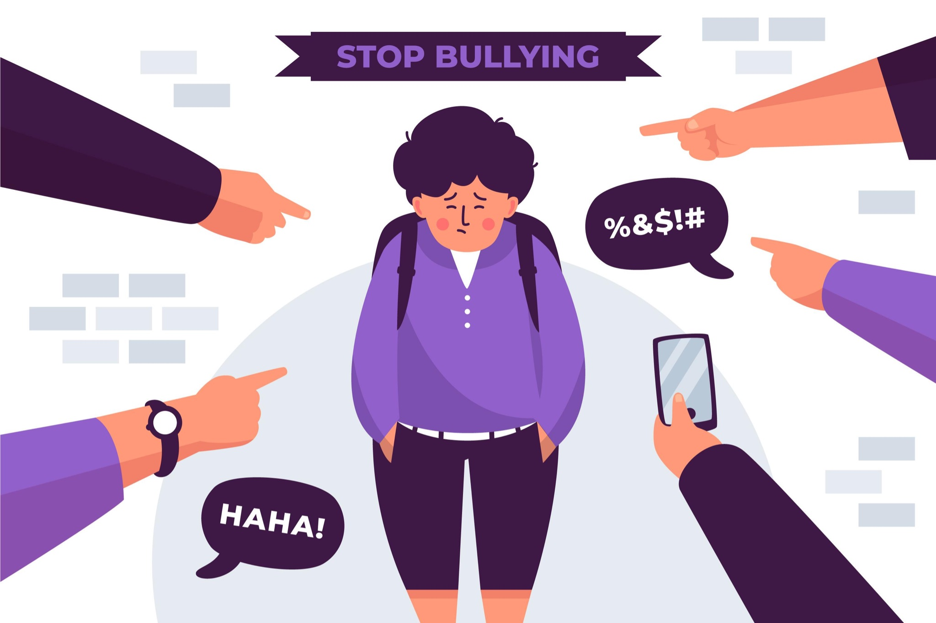
2. Verbal Bullying
Verbal bullying refers to saying mean words in order to insult or embarrass someone.
This form of bullying includes name-calling, verbal abuse, threats, homophobic remarks and teasing.
It might be challenging to recognise such forms of bullying, especially for teachers as many of these verbal attacks occur in private, when no adults are there.
This form of bullying can leave the victim with deep emotional traumas and can also occur along with physical bullying
Image by <a href="https://www.freepik.com/free-vector/stop-bullying-concept_8850051.htm#page=2&query=stop%20bullying&position=3&from_view=search&track=ais">Freepik</a>

Slide 5
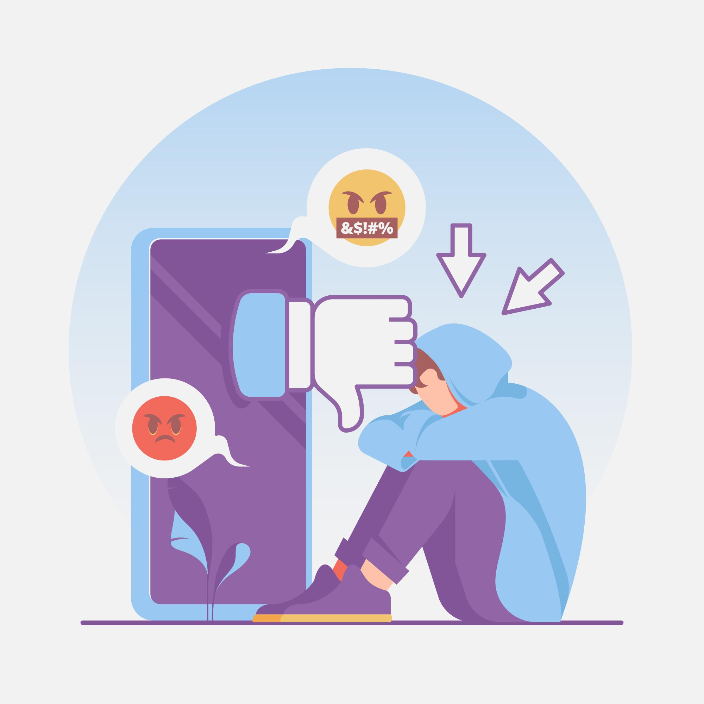
3. Cyber-bullying
Cyber-bullying
Hostile behaviours committed deliberately and repeatedly online against an individual who is unable to protect themselves is known as cyberbullying.
Cyberbullying may take the following forms: sending hurtful messages, posting humiliating images or videos, impersonation, and exclusion from group conversations. Cyberbullying shares many similarities with conventional bullying in that it frequently involves the same offenders and increases the victims exposure to bullying.
Repetition is not one of the most important criteria in cyberbullying because certain unrepeated acts, like uploading a humiliating or insulting photo online, can hurt the victim by repeatedly exposing them to others (Keating et al., 2020).
The negative effects of cyberbullying can be disturbing and damaging for children and young people which is concerning as according to current studies show that among a sample of young Irish teenagers, 12.4% of post-primary students were bullied online (Foody et al., 2019)
Research shows that adolescents frequently defend cyber-bullying behaviours like name-calling as light hearted jokes. It is believed that these young people find it difficult to distinguish between humour and cyberbullying in a digital setting, which might cause them to underestimate the seriousness of their behaviour (Baas et al., 2013).
The anonymity and distance provided by the online environment can create a sense of detachment from the consequences of one's actions, leading to a lack of empathy and an underestimation of the harm caused to the victims. It is crucial to promote empathy and responsible online behaviour among young people.
<a href="https://www.freepik.com/free-vector/cyber-bullying-concept_8967117.htm#query=cyber%20bullying&position=4&from_view=search&track=ais">Image by pikisuperstar</a> on Freepik

Slide 6
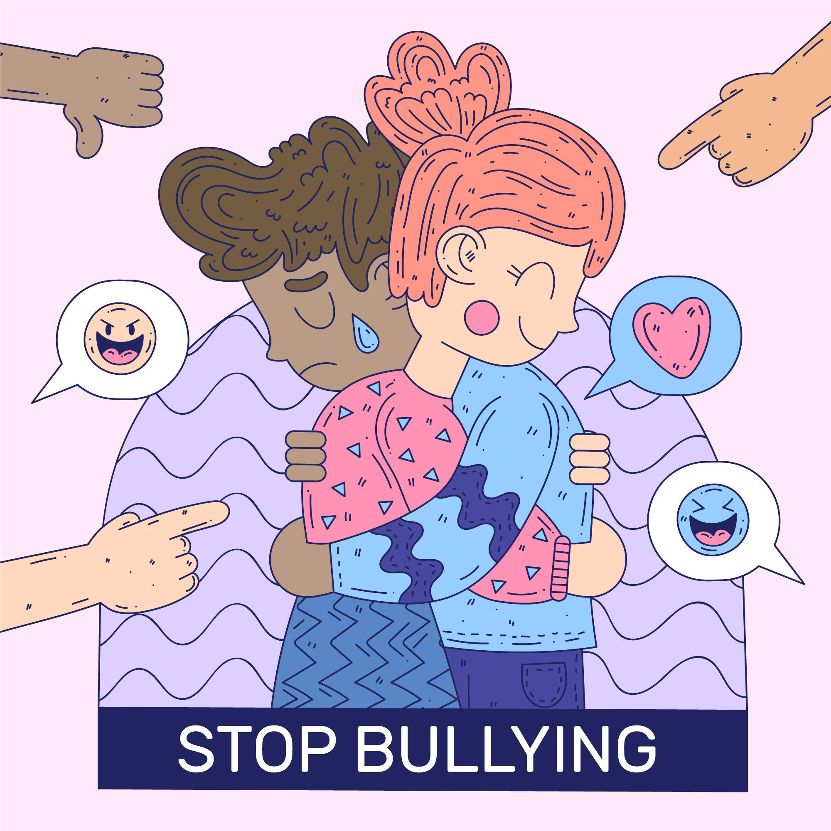
4. Social Bullying
Social bullying also known as relational aggression - involves harming an individual’s relationships.
This can be done by exclusion, spreading false rumours or embarrassing secrets without the victim knowing.
This can lead to the victim being isolated and is damaging to their confidence and mental health.
Social bullying more difficulty to identify than other forms of bullying and is more common among young girls.
Image by <a href="https://www.freepik.com/free-vector/stop-bullying-illustration-design_9099552.htm#page=2&query=social%20bullying&position=7&from_view=search&track=ais">Freepik</a>

Slide 7

5. Prejudiced Bullying
Prejudiced bullying – occurs when someone is the target of bullying based on their race, religion, or sexual orientation.
Prejudiced bullying can be physical, verbal, and cyberbullying, and is based on the bully's preconceptions and prejudices.
Prejudiced bully and discrimination can have a serious detrimental impact on the victims mental health.
All incidents of discriminatory bullying should be taken seriously as prejudiced bullying can lead to hate crimes and intolerance.
Image by <a href="https://www.freepik.com/free-vector/multiracial-enraged-raised-fists_9884789.htm#query=equality&position=4&from_view=search&track=sph">Freepik</a>

Slide 8
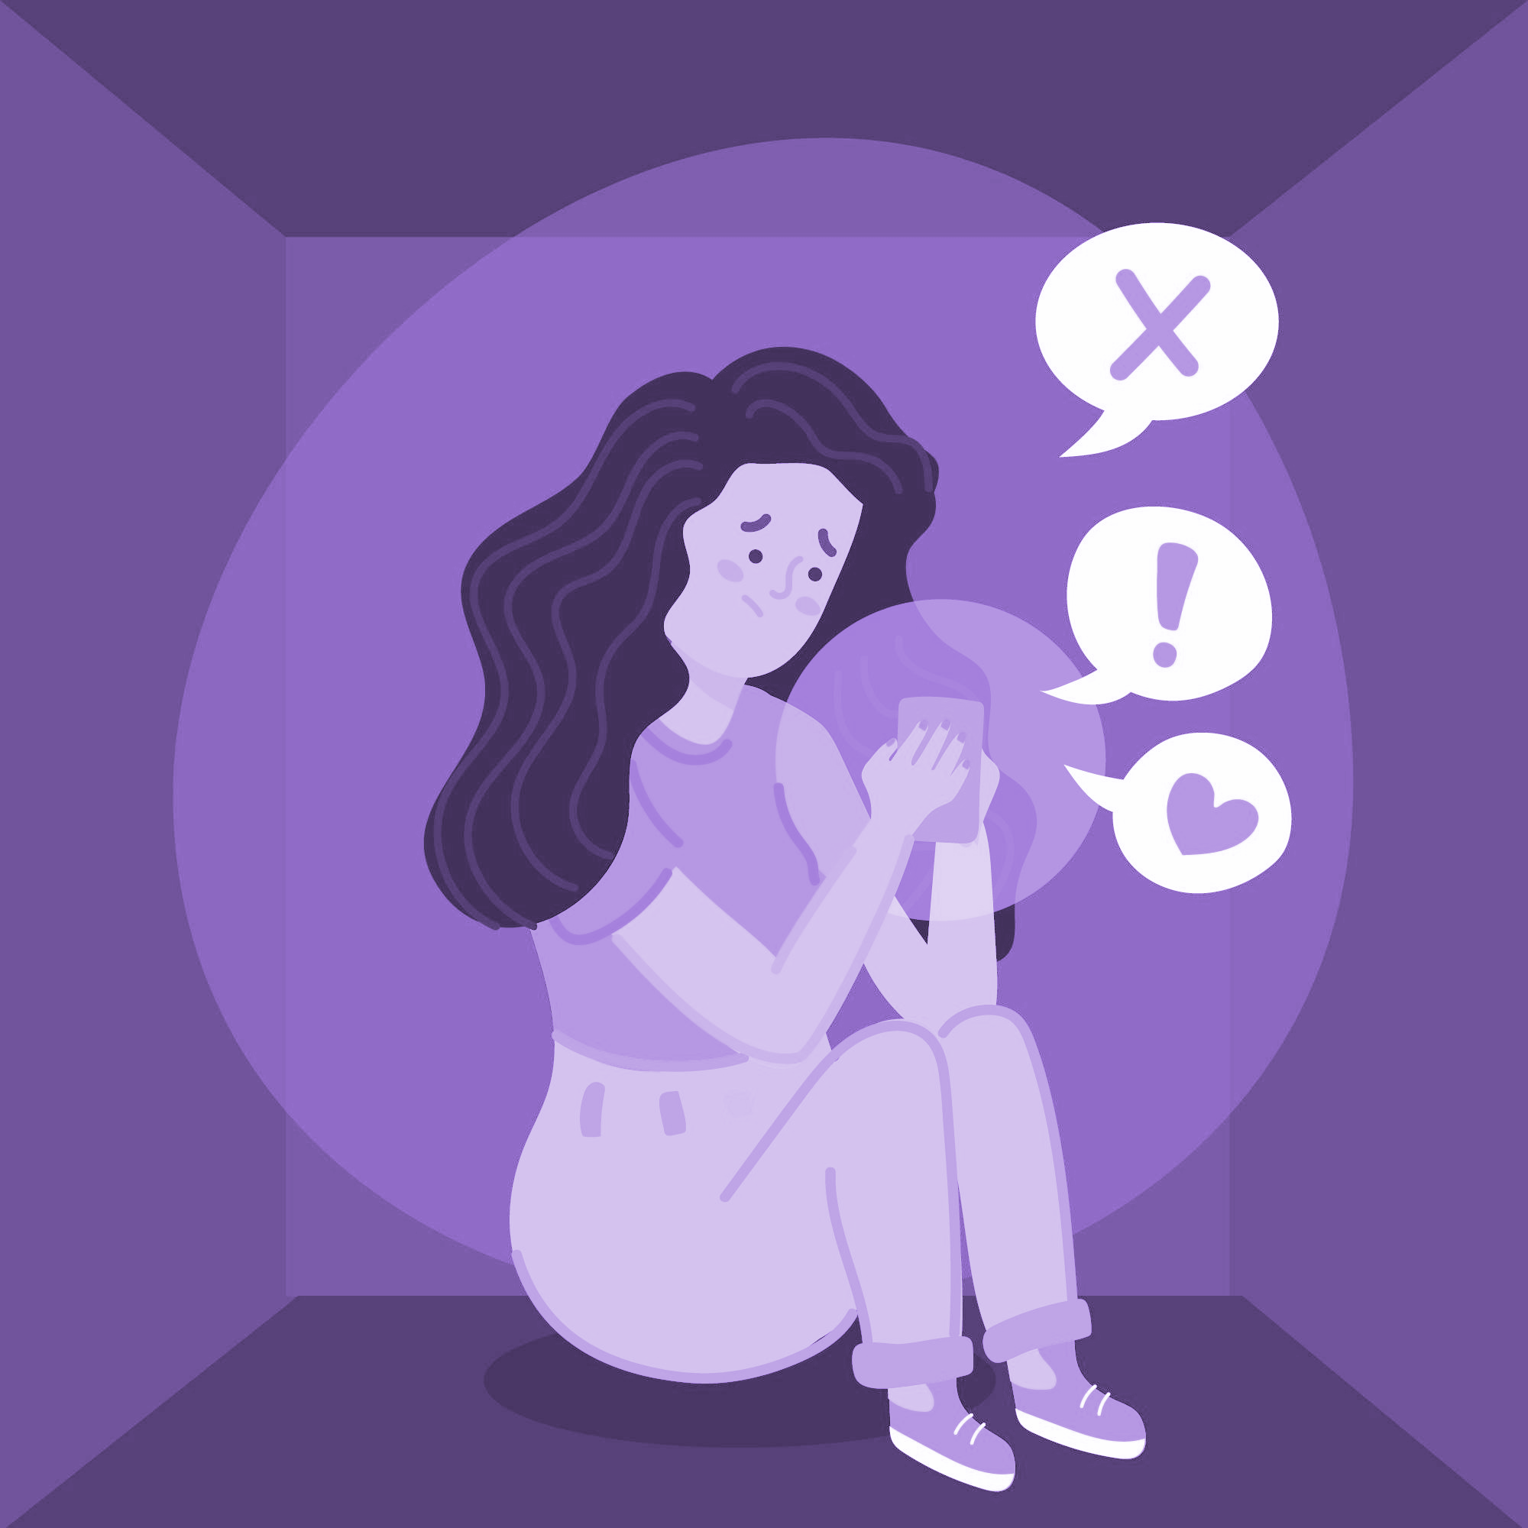
6. Sexual Bullying
Sexual bullying – Involves the use of harmful behaviours aimed at targeting and shaming victims in a sexual manner.
Inappropriate jokes, sexual name-calling, uninvited touching, sharing intimate images without consent and spreading sexual rumours are all forms of sexual bullying.
Such behaviours occur both in and out of school or online.
Sexual bullying can have long term impacts on the victim such as trust issues, poor mental health and self-esteem.
Sexual bully impacts all genders however girl are primarily the most targeted group.
Image by <a href="https://www.freepik.com/free-vector/fear-missing-out-concept_9884678.htm#query=cartoon%20girl%20on%20phone%20upset&position=47&from_view=search&track=ais">Freepik</a>

