Slide 1


What do you think when you hear the word Childline?
Lap
and
Chat

Slide 2

LET’S
What do you think when you hear the word Childline?
SWEAT
IT
March 27 to April 2 2023
TOGETHER

Slide 3



What do you think when you hear the word Childline?
Each year, up to 75% of our
funding needs to be raised from
donations. We need to continually
fundraise to provide our suite of
services and supports.
To ensure our 24hr support line is
available 24/7, 365 days,
€12,000 is needed each day.
LET’S
Who We Are
We are dedicated to enhancing the lives of children and young people; they are at the heart of everything we do.​
​
Founded in 1889, we are Ireland’s oldest and most well-known children’s charity. ​
We have a long, proud history of safeguarding, service delivery and advocacy on behalf of children.
SWEAT
IT
TOGETHER

Slide 4










MAR
27
MON
Sunny
16℃
Digital Programmes
Childline
CTSS
Shield
Smart Moves
Support Line

Slide 5
MAR
27
MON
Sunny
16℃
Digital Programmes
Childline Listening
CTSS
Shield
Smart Moves
Support Line

Slide 6
ISPCC Childline is for children, young people and their parents.
We listen, we believe, we support and we empower.
We provide services which focus on building resilience and coping skills. These are focused in the following area’s:
Childline Listening
Childline therapeutic support
Childline Community Engagement
Childline.ie Digital Supports
Childline by ISPCC
MAR
27
MON
Childline is a listening service for children and young people up to the age of 18 years.
It is a completely confidential service, no phone numbers or details are kept. It is up to you what details/information you want to share.
It is a non judgemental service where we will explore options to support you.
It is available via phone 24hrs a day by calling 1800 66 66 66 and is completely free of charge.
You also have the option of using our live web chat.
Sunny
16℃
Digital Programmes
Childline Listening
CTSS
Shield
Smart Moves
Support Line
MAR
27
MON
Sunny
16℃
Digital Programmes
Childline
CTSS
Shield
Smart Moves
Support Line

Slide 7


Anytime, Any Reason
Mental and Emotional Health
Lonely
Disabilities and different abilities
Family Relationships
Anxiety
School life
Friendships
Relationships
Me and my body
Home Life
Bullying
Sexuality
Online Safety
Everyday life, hobbies and interests
Physical / sexual / mental abuse or assault
Self harm and suicide
Notes:
Reasons Young people may call – ask for engagement from the group on this prior to bring up the top reasons.

Slide 8
ISPCC Childline is for children, young people and their parents.
We listen, we believe, we support and we empower.
We provide services which focus on building resilience and coping skills. These are focused in the following area’s:
Childline Listening
Childline therapeutic support
Childline Community Engagement
Childline.ie Digital Supports
Childline by ISPCC
MAR
27
MON
The top three reasons we were contacted in 2022:
Mental and emotional health.
Family relationships.
Friendship and peer relationships.
If your question is urgent, or if want to talk privately, contact Childline for free by calling 1800 66 66 66 or chatting online 24 hours a day, every day.
The Childline team spent 1.1 million minutes on the phone in 2023.
Sunny
16℃
Digital Programmes
Childline Listening
CTSS
Shield
Smart Moves
Support Line
MAR
27
MON
Sunny
16℃
Digital Programmes
Childline
CTSS
Shield
Smart Moves
Support Line

Slide 9
ISPCC Childline is for children, young people and their parents.
We listen, we believe, we support and we empower.
We provide services which focus on building resilience and coping skills. These are focused in the following area’s:
Childline Listening
Childline therapeutic support
Childline Community Engagement
Childline.ie Digital Supports
Childline
MAR
27
MON
Sunny
16℃
Digital Programmes
Childline
CTSS
Shield
Smart Moves
Support Line
Childline is a listening service for children and young people up to the age of 18 years.
It is a completely confidential service, no phone numbers or details are kept. It is up to you what details/information you want to share.
It is a non judgemental service where we wont tell you what to do, instead we will explore options it with you.
It is available via phone 24hrs a day by calling 1800 66 66 66 and is completely free of charge.
You also have the option of using our live web chat on www.childline.ie

Slide 10
ISPCC Childline is for children, young people and their parents.
We listen, we believe, we support and we empower.
We provide services which focus on building resilience and coping skills. These are focused in the following area’s:
Childline Listening
Childline therapeutic support
Childline Community Engagement
Childline.ie Digital Supports
Shield
Childline
MAR
27
MON
Sunny
16℃
Digital Programmes
Childline
CTSS
Shield
Smart Moves
Support Line
Childline is a listening service for children and young people up to the age of 18 years.
It is a completely confidential service, no phone numbers or details are kept. It is up to you what details/information you want to share.
It is a non judgemental service where we wont tell you what to do, instead we will explore options it with you.
It is available via phone 24hrs a day by calling 1800 66 66 66 and is completely free of charge.
You also have the option of using our live web chat on www.childline.ie

Slide 11
ISPCC Childline is for children, young people and their parents.
We listen, we believe, we support and we empower.
We provide services which focus on building resilience and coping skills. These are focused in the following area’s:
Childline Listening
Childline therapeutic support
Childline Community Engagement
Childline.ie Digital Supports
Childline
Shield
The Shield Anti-Bullying Programme is a pro-active management to bullying.
Shield Programme is there for schools, clubs, youth centres, any organisation that wants to prevent bullying from happening.
It contains a Self-Evaluation Tool that organisations can fill out to reflect on their strengths and what supports they need when it comes to tackling bullying.
To sign up, visit the Shield Website on ispcc.ie or email shield@ispcc.ie
Childline is a listening service for children and young people up to the age of 18 years.
It is a completely confidential service, no phone numbers or details are kept. It is up to you what details/information you want to share.
It is a non judgemental service where we wont tell you what to do, instead we will explore options it with you.
It is available via phone 24hrs a day by calling 1800 66 66 66 and is completely free of charge.
You also have the option of using our live web chat on www.childline.ie
MAR
27
MON
Sunny
16℃
Digital Programmes
Childline
CTSS
Shield
Smart Moves
Support Line

Slide 12
ISPCC Childline is for children, young people and their parents.
We listen, we believe, we support and we empower.
We provide services which focus on building resilience and coping skills. These are focused in the following area’s:
Childline Listening
Childline therapeutic support
Childline Community Engagement
Childline.ie Digital Supports
Shield
Childline
The Shield Anti-Bullying Programme is a pro-active management to bullying.
Shield Programme is there for schools, clubs, youth centres, any organisation that wants to prevent bullying from happening.
It contains a Self-Evaluation Tool that organisations can fill out to reflect on their strengths and what supports they need when it comes to tackling bullying.
To sign up, visit the Shield Website on ispcc.ie or email shield@ispcc.ie
MAR
27
MON
Sunny
16℃
Digital Programmes
Childline
CTSS
Shield
Smart Moves
Support Line
Childline is a listening service for children and young people up to the age of 18 years.
It is a completely confidential service, no phone numbers or details are kept. It is up to you what details/information you want to share.
It is a non judgemental service where we wont tell you what to do, instead we will explore options it with you.
It is available via phone 24hrs a day by calling 1800 66 66 66 and is completely free of charge.
You also have the option of using our live web chat on www.childline.ie

Slide 13
ISPCC Childline is for children, young people and their parents.
We listen, we believe, we support and we empower.
We provide services which focus on building resilience and coping skills. These are focused in the following area’s:
Childline Listening
Childline therapeutic support
Childline Community Engagement
Childline.ie Digital Supports
Digital Mental Health and Wellbeing Programmes
Shield
Childline
The Shield Anti-Bullying Programme is a pro-active management to bullying.
Shield Programme is there for schools, clubs, youth centres, any organisation that wants to prevent bullying from happening.
It contains a Self-Evaluation Tool that organisations can fill out to reflect on their strengths and what supports they need when it comes to tackling bullying.
To sign up, visit the Shield Website on ispcc.ie or email shield@ispcc.ie
MAR
27
MON
Sunny
16℃
Digital Programmes
Childline
CTSS
Shield
Smart Moves
Support Line
Childline is a listening service for children and young people up to the age of 18 years.
It is a completely confidential service, no phone numbers or details are kept. It is up to you what details/information you want to share.
It is a non judgemental service where we wont tell you what to do, instead we will explore options it with you.
It is available via phone 24hrs a day by calling 1800 66 66 66 and is completely free of charge.
You also have the option of using our live web chat on www.childline.ie

Slide 14
ISPCC Childline is for children, young people and their parents.
We listen, we believe, we support and we empower.
We provide services which focus on building resilience and coping skills. These are focused in the following area’s:
Childline Listening
Childline therapeutic support
Childline Community Engagement
Childline.ie Digital Supports
Shield
Childline
The Shield Anti-Bullying Programme is a pro-active management to bullying.
Shield Programme is there for schools, clubs, youth centres, any organisation that wants to prevent bullying from happening.
It contains a Self-Evaluation Tool that organisations can fill out to reflect on their strengths and what supports they need when it comes to tackling bullying.
To sign up, visit the Shield Website on ispcc.ie or email shield@ispcc.ie
Digital Mental Health and Wellbeing Programmes
Space from Anxiety - Young People aged 15 – 18​​ or Supporting an anxious teen 12-18.
Space From Anxiety teaches young people to recognise their own anxiety and gain techniques they can use to cope with it.​
Online courses/programmes that focus on dealing with low to medium anxiety. ​
How to access the digital mental health and wellbeing programmes:​​
Ask your parent/caregiver or teacher to make a referral. ​​
spacefromanxiety@ispcc.ie
MAR
27
MON
Childline is a listening service for children and young people up to the age of 18 years.
It is a completely confidential service, no phone numbers or details are kept. It is up to you what details/information you want to share.
It is a non judgemental service where we wont tell you what to do, instead we will explore options it with you.
It is available via phone 24hrs a day by calling 1800 66 66 66 and is completely free of charge.
You also have the option of using our live web chat on www.childline.ie
Sunny
16℃
Digital Programmes
Childline
CTSS
Shield
Smart Moves
Support Line

Slide 15
ISPCC Childline is for children, young people and their parents.
We listen, we believe, we support and we empower.
We provide services which focus on building resilience and coping skills. These are focused in the following area’s:
Childline Listening
Childline therapeutic support
Childline Community Engagement
Childline.ie Digital Supports
Space from Anxiety - Young People aged 14 - 18
Children and young people who experience low to moderate anxiety.
The programme is designed to assist young people in reducing the distress associated with anxiety.
Space From Anxiety teaches young people techniques they can use every day to help them cope with whatever might come their way.
Supporting an Anxious Child
For parents or carers to help them explore anxiety and support your child or young person. parent/carer looking to support your 5-11 year old child who experiences low to moderate anxiety
Supporting an Anxious Teen
If you are a parent/carer looking to support your 12-18 year old teenager who experiences low to moderate anxiety, our
Shield
Childline
Digital Mental Health and Wellbeing Programmes
The Shield Anti-Bullying Programme is a pro-active management to bullying.
Shield Programme is there for schools, clubs, youth centres, any organisation that wants to prevent bullying from happening.
It contains a Self-Evaluation Tool that organisations can fill out to reflect on their strengths and what supports they need when it comes to tackling bullying.
To sign up, visit the Shield Website on ispcc.ie or email shield@ispcc.ie
MAR
27
MON
Sunny
16℃
Digital Programmes
Childline
CTSS
Shield
Smart Moves
Support Line
Childline is a listening service for children and young people up to the age of 18 years.
It is a completely confidential service, no phone numbers or details are kept. It is up to you what details/information you want to share.
It is a non judgemental service where we wont tell you what to do, instead we will explore options it with you.
It is available via phone 24hrs a day by calling 1800 66 66 66 and is completely free of charge.
You also have the option of using our live web chat on www.childline.ie

Slide 16
ISPCC Childline is for children, young people and their parents.
We listen, we believe, we support and we empower.
We provide services which focus on building resilience and coping skills. These are focused in the following area’s:
Childline Listening
Childline therapeutic support
Childline Community Engagement
Childline.ie Digital Supports
Smart Moves
Space from Anxiety - Young People aged 14 - 18
Children and young people who experience low to moderate anxiety.
The programme is designed to assist young people in reducing the distress associated with anxiety.
Space From Anxiety teaches young people techniques they can use every day to help them cope with whatever might come their way.
Supporting an Anxious Child
For parents or carers to help them explore anxiety and support your child or young person. parent/carer looking to support your 5-11 year old child who experiences low to moderate anxiety
Supporting an Anxious Teen
If you are a parent/carer looking to support your 12-18 year old teenager who experiences low to moderate anxiety, our
Shield
Childline
Digital Mental Health and Wellbeing Programmes
The Shield Anti-Bullying Programme is a pro-active management to bullying.
Shield Programme is there for schools, clubs, youth centres, any organisation that wants to prevent bullying from happening.
It contains a Self-Evaluation Tool that organisations can fill out to reflect on their strengths and what supports they need when it comes to tackling bullying.
To sign up, visit the Shield Website on ispcc.ie or email shield@ispcc.ie
MAR
27
MON
Sunny
16℃
Digital Programmes
Childline
CTSS
Shield
Smart Moves
Support Line
Childline is a listening service for children and young people up to the age of 18 years.
It is a completely confidential service, no phone numbers or details are kept. It is up to you what details/information you want to share.
It is a non judgemental service where we wont tell you what to do, instead we will explore options it with you.
It is available via phone 24hrs a day by calling 1800 66 66 66 and is completely free of charge.
You also have the option of using our live web chat on www.childline.ie
Smart Moves is a suite of evidence-based short sessions, led by teachers to give young people small, learnable skills that increase resilience.
It aims to support the emotional resilience of children as they prepare to transition from primary to secondary school.
Can be completed by both 5th and 6th class students as well as first year students.
Available to schools within the republic of Ireland.

Slide 17

ISPCC Childline is for children, young people and their parents.
We listen, we believe, we support and we empower.
We provide services which focus on building resilience and coping skills. These are focused in the following area’s:
Childline Listening
Childline therapeutic support
Childline Community Engagement
Childline.ie Digital Supports
Shield
Childline
The Shield Anti-Bullying Programme is a pro-active management to bullying.
Shield Programme is there for schools, clubs, youth centres, any organisation that wants to prevent bullying from happening.
It contains a Self-Evaluation Tool that organisations can fill out to reflect on their strengths and what supports they need when it comes to tackling bullying.
To sign up, visit the Shield Website on ispcc.ie or email shield@ispcc.ie
Sadness
Sadness is a basic human emotion, a natural response to situations that you find upsetting, painful or disappointing. You may feel better after crying or talking to a friend. As humans, we can’t avoid feeling sad at times, but this emotion can help us to grow and develop as people.
Sadness is a normal emotion, it’s part of what makes us human.
Everyone feels sad emotions, but it’s a temporary emotion; it will pass and you will feel better.
Sadness can actually help us because it can prompt us to focus on what is important to us, who we love and what we want from life.
Try not to beat yourself up for how you feel. It doesn’t matter if you’re sad over something big or something small. If it matters to you, that’s all that counts.
MAR
27
MON
Childline is a listening service for children and young people up to the age of 18 years.
It is a completely confidential service, no phone numbers or details are kept. It is up to you what details/information you want to share.
It is a non judgemental service where we wont tell you what to do, instead we will explore options it with you.
It is available via phone 24hrs a day by calling 1800 66 66 66 and is completely free of charge.
You also have the option of using our live web chat on www.childline.ie
Sunny
16℃
Digital Programmes
Childline
CTSS
Shield
Smart Moves
Support Line

Slide 18
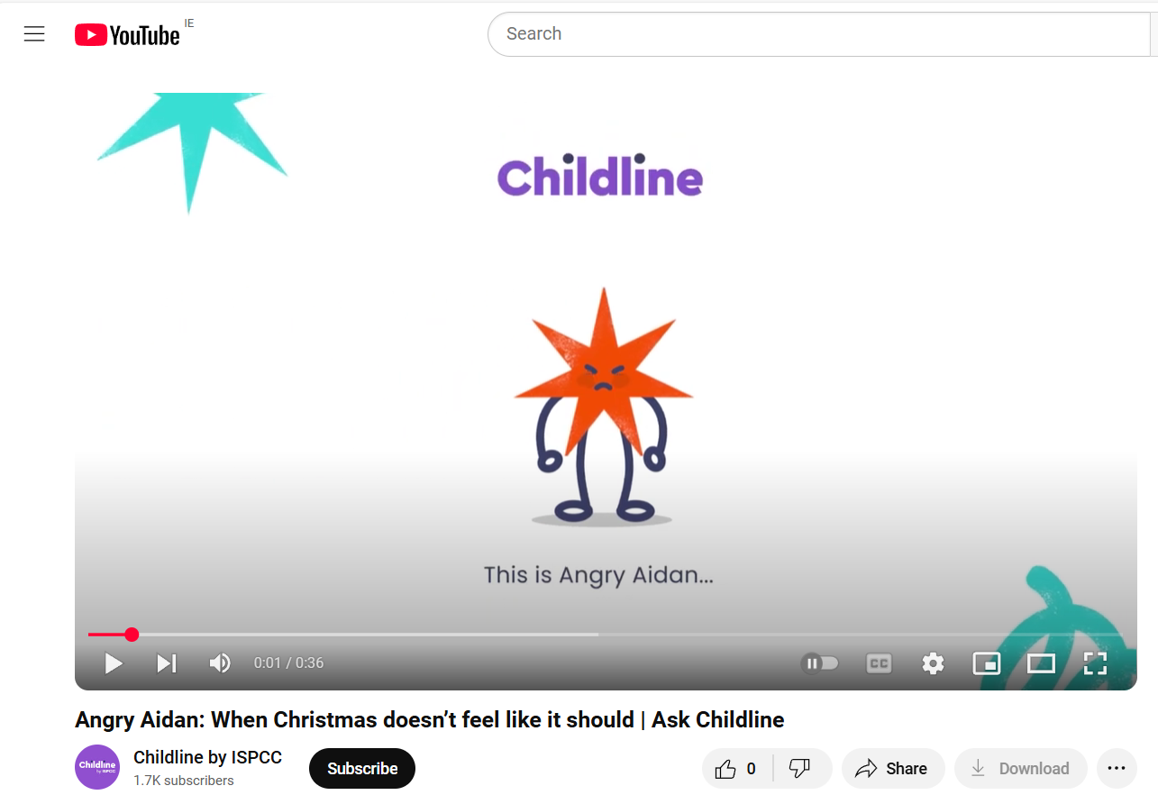
ISPCC Childline is for children, young people and their parents.
We listen, we believe, we support and we empower.
We provide services which focus on building resilience and coping skills. These are focused in the following area’s:
Childline Listening
Childline therapeutic support
Childline Community Engagement
Childline.ie Digital Supports
Shield
Childline
This is Angry Aidan
Childline is a listening service for children and young people up to the age of 18 years.
It is a completely confidential service, no phone numbers or details are kept. It is up to you what details/information you want to share.
It is a non judgemental service where we wont tell you what to do, instead we will explore options it with you.
It is available via phone 24hrs a day by calling 1800 66 66 66 and is completely free of charge.
You also have the option of using our live web chat on www.childline.ie
MAR
27
MON
Sunny
16℃
Digital Programmes
Childline
CTSS
Shield
Smart Moves
Support Line

Slide 19

ISPCC Childline is for children, young people and their parents.
We listen, we believe, we support and we empower.
We provide services which focus on building resilience and coping skills. These are focused in the following area’s:
Childline Listening
Childline therapeutic support
Childline Community Engagement
Childline.ie Digital Supports
Shield
Childline
Angry
We all get angry at times. It’s normal – and healthy – to feel anger when we’re frustrated, are unhappy with a situation or feel we have been treated badly. Sometimes we don’t even know why we feel this way. Anger can manifest as a physical rush of energy (adrenaline). Learning to understand why we get angry won’t always stop us from feeling this way, but it will help us to manage it.
Spotting the signs that you’re starting to get angry can help you to know when things might be getting out of control.
When you’re calmly trying to manage your anger, try to recognise your triggers, for example feeling scared or frustrated.
If you’re struggling to control your behaviour, we can support you.
Childline is a listening service for children and young people up to the age of 18 years.
It is a completely confidential service, no phone numbers or details are kept. It is up to you what details/information you want to share.
It is a non judgemental service where we wont tell you what to do, instead we will explore options it with you.
It is available via phone 24hrs a day by calling 1800 66 66 66 and is completely free of charge.
You also have the option of using our live web chat on www.childline.ie
MAR
27
MON
Sunny
16℃
Digital Programmes
Childline
CTSS
Shield
Smart Moves
Support Line

Slide 20

ISPCC Childline is for children, young people and their parents.
We listen, we believe, we support and we empower.
We provide services which focus on building resilience and coping skills. These are focused in the following area’s:
Childline Listening
Childline therapeutic support
Childline Community Engagement
Childline.ie Digital Supports
Shield
Childline
Lonely
Being lonely doesn’t actually mean that you’re physically on your own. You could be surrounded by people – family, friends, schoolmates – but if you feel as if you’re on your own, or that nobody really understands or gets you, then you’re lonely. This is a feeling that can make you feel very down and isolated. But there is always help available.
Everyone feels lonely at times, and that is okay.
There are many reasons why someone would feel lonely, including if you have moved house, been bullied or lost someone close to you.
The number of friends you have isn’t important. What matters is having friends that you’re close to, who support you and won’t try to hurt you or bully you
Childline is a listening service for children and young people up to the age of 18 years.
It is a completely confidential service, no phone numbers or details are kept. It is up to you what details/information you want to share.
It is a non judgemental service where we wont tell you what to do, instead we will explore options it with you.
It is available via phone 24hrs a day by calling 1800 66 66 66 and is completely free of charge.
You also have the option of using our live web chat on www.childline.ie
MAR
27
MON
Sunny
16℃
Digital Programmes
Childline
CTSS
Shield
Smart Moves
Support Line

Slide 21

ISPCC Childline is for children, young people and their parents.
We listen, we believe, we support and we empower.
We provide services which focus on building resilience and coping skills. These are focused in the following area’s:
Childline Listening
Childline therapeutic support
Childline Community Engagement
Childline.ie Digital Supports
Shield
Childline
Afraid
Being afraid is feeling fear or worry about the possible results of a particular situation. We all feel afraid at times, and we all have different triggers for our fears. It’s totally natural to feel afraid of dogs, to worry about losing your parents or to be concerned about the environment. It is very different when you’re afraid of someone hurting you. No one has the right to hurt or threaten you in any way.
We all feel afraid at times, and we all have different triggers for our fears.
No one has the right to hurt or threaten you in any way.
Intrusive thoughts are strange or disturbing thoughts that can pop into your head without warning, at any time. They are completely normal, but can be very frightening.
Acknowledging our worries and taking the time to say them out loud to someone we trust can help us feel more in control.
Childline is a listening service for children and young people up to the age of 18 years.
It is a completely confidential service, no phone numbers or details are kept. It is up to you what details/information you want to share.
It is a non judgemental service where we wont tell you what to do, instead we will explore options it with you.
It is available via phone 24hrs a day by calling 1800 66 66 66 and is completely free of charge.
You also have the option of using our live web chat on www.childline.ie
MAR
27
MON
Sunny
16℃
Digital Programmes
Childline
CTSS
Shield
Smart Moves
Support Line

Slide 22

ISPCC Childline is for children, young people and their parents.
We listen, we believe, we support and we empower.
We provide services which focus on building resilience and coping skills. These are focused in the following area’s:
Childline Listening
Childline therapeutic support
Childline Community Engagement
Childline.ie Digital Supports
Shield
Childline
Anxious
Anxiety is a feeling you get when you’re worried or scared about something. Some anxiety can be helpful. It can help keep you safe by prompting you to think about the situation you’re in. It can motivate you to do your best. For example, if you’re anxious about an exam and decide you need to study hard for it. But anxiety can be unhelpful too. It might make you feel as if things are worse than they actually are. It can feel overwhelming and make it hard to get perspective.
We all feel anxious at times.
Practise positive self-talk, self-compassion and assertiveness.
When you start to have negative thoughts, take time to be kind to yourself and think about what a good friend would say about you in that moment.
If your anxiety is stopping you from being able to live your life or do the things you usually enjoy, it’s time to get help
Childline is a listening service for children and young people up to the age of 18 years.
It is a completely confidential service, no phone numbers or details are kept. It is up to you what details/information you want to share.
It is a non judgemental service where we wont tell you what to do, instead we will explore options it with you.
It is available via phone 24hrs a day by calling 1800 66 66 66 and is completely free of charge.
You also have the option of using our live web chat on www.childline.ie
MAR
27
MON
Sunny
16℃
Digital Programmes
Childline
CTSS
Shield
Smart Moves
Support Line

Slide 23
ISPCC Childline is for children, young people and their parents.
We listen, we believe, we support and we empower.
We provide services which focus on building resilience and coping skills. These are focused in the following area’s:
Childline Listening
Childline therapeutic support
Childline Community Engagement
Childline.ie Digital Supports
Childline
MAR
27
MON
Lap and Chat
Sunny
16℃
What is a Lap and Chat?
Pair up with a friend in your class and take a few laps around your yard, school or in your local area.
Chat about what is on your mind and what may be worrying you.
Don’t forget to listen to your friends worries during your lap.
Reflect about your lap and chat in the activity book!
Give back to Childline by donating on your schools fundraising page.
Digital Programmes
Childline Listening
CTSS
Shield
Smart Moves
Support Line
Childline is a listening service for children and young people up to the age of 18 years.
It is a completely confidential service, no phone numbers or details are kept. It is up to you what details/information you want to share.
It is a non judgemental service where we wont tell you what to do, instead we will explore options it with you.
It is available via phone 24hrs a day by calling 1800 66 66 66 and is completely free of charge.
You also have the option of using our live web chat on www.childline.ie

Slide 24
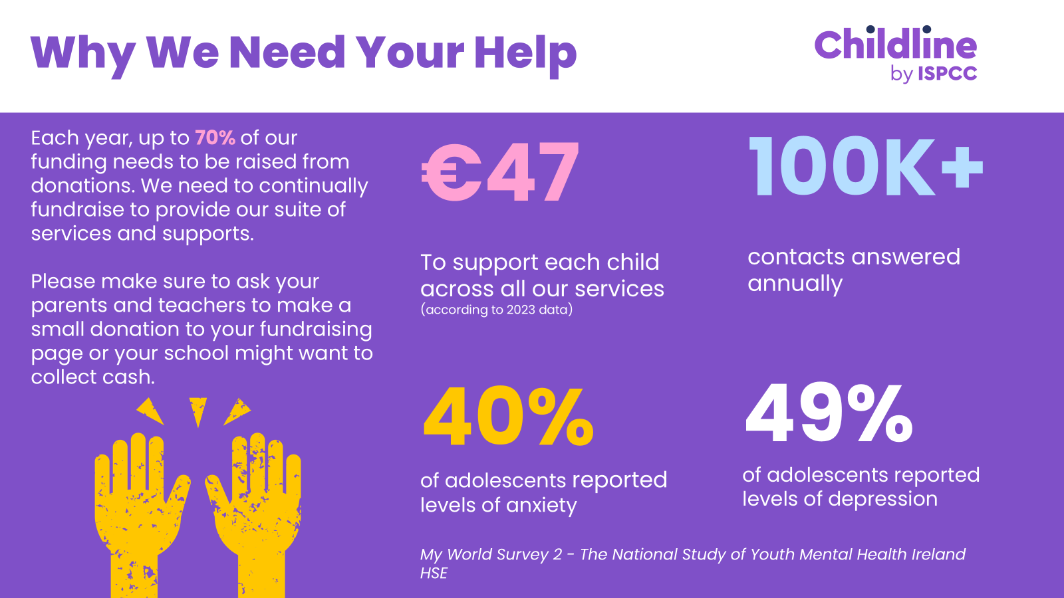
What do you think when you hear the word Childline?
LET’S
Why We Need Your Help
Each year, up to 75% of our
funding needs to be raised from
donations. We need to continually
fundraise to provide our suite of
services and supports.
To ensure our 24hr support line is
available 24/7, 365 days,
€12,000 is needed each day.
3,914
Were on the CAMHS
waiting list in February 2022
100K+
contacts answered
annually
49%
of adolescents reported
levels of depression
SWEAT
IT
40%
of adolescents reported
levels of anxiety
My World Survey 2 - The National Study of Youth Mental Health Ireland
HSE February
TOGETHER

Slide 25
Any Questions?

